Slide 1

EDYODA
ROS 2 + PX4: Architecture, Integration & Industrial Applications
Practical Session

Slide 2
Agenda
Build PX4 with uXRCE-DDS client
Start XRCE agent on laptop/OBC
Connect PX4 ↔ ROS 2 via DDS
Visualize PX4 topics inside ROS 2
Publish commands from ROS 2 to PX4
Understand communication flow hands-on

Slide 3
PX4 with ROS2
Practical Session

Slide 4
System Setup Requirements
What learners need:
ROS 2 (Humble)
PX4-Autopilot (latest main or v1.14+)
Colcon workspace with px4_msgs
Micro-XRCEAgent installed
QGroundControl GCS

Slide 5
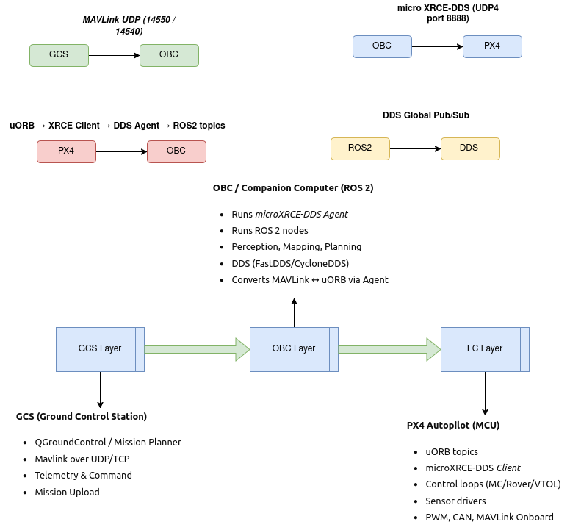
Architecture We Will Implement Today

Slide 6
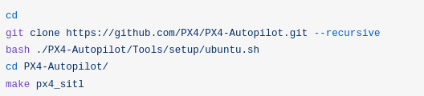

Step 1 - PX4 Firmware Preparation
Demonstration:
Clone PX4-Autopilot
Run dependencies script
Build with uXRCE-DDS enabled
Run the command after px4_sitl

Slide 7


Step 2 - Start the Micro XRCE-DDS Agent
Demonstration:
Install from a snap package on Ubuntu using the following command:
To start the agent with settings for connecting to the uXRCE-DDS client running on the simulator (note that the command name is different than if you build the agent locally):

Slide 8



Step 3 Build ROS 2 Workspace with px4_msgs
Building the Workspace
1. To create and build the workspace:
Open a new terminal.
Create and navigate into a new workspace directory using
2. Clone the example repository and px4_msgs to the /src directory (the main branch is cloned by default, which corresponds to the version of PX4 we are running):
Source the ROS 2 development environment into the current terminal and compile the workspace using colcon:

Slide 9
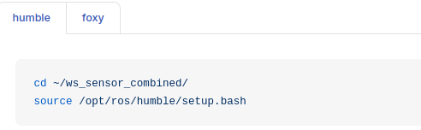
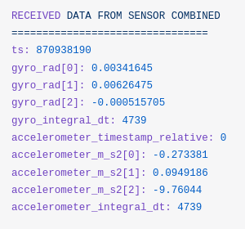

Executing the ROS2 Workspace
Navigate into the top level of your workspace directory and source the ROS 2 environment (in this case "Humble"):
Source the local_setup.bash.
Now launch the example. Note here that we use ros2 launch, which is described below.

Slide 10
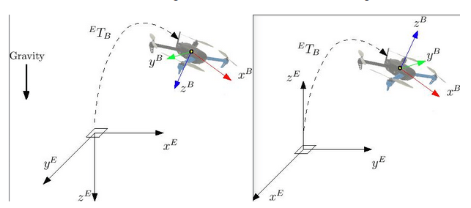
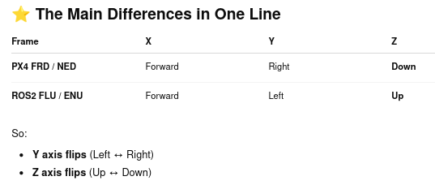
PX4 vs ROS2 Frames
Think of drones as living in two "worlds":
PX4 World
PX4 uses FRD / NED frames
Think of airplane style, used by aerospace engineers.
ROS2 World
ROS2 uses FLU / ENU frames
Think of robot style, used by ground robots and cameras.
Because both speak different “orientation languages”, we must translate between them.

Slide 11
Why 2 Rotations
To convert world frame vectors (like position, velocity), you need:
ENU → NED (ROS → PX4)
Rotate around Z-axis
Rotate around X-axis
This just reorders and flips axes.
📝 Don't worry about the math. Just understand: it’s like rotating a 3D model to match another coordinate system.
FLU → FRD (ROS → PX4)
Just flip the Z axis (Up → Down). This is a simple 180° rotation about X-axis.
Example:
Thrust in ROS2: “push up”
PX4 expects: “push down” (because Z-down is positive)

Slide 12
Why Translation is Required
This system is used in: PX4
Aviation language
aviation
autopilots
GPS navigation
inertial navigation systems
This is standard in:ROS2
Robotics language
robotics
SLAM
cameras
LiDAR
computer vision
Movement | PX4 Meaning | ROS Meaning
Z positive | Down | Up
Y positive | Right | Left

Slide 13
Which PX4 Messages Need Rotation?
1. TrajectorySetpoint
Position, velocity, acceleration
Must be converted ENU → NED
2. VehicleThrustSetpoint
Forces
Must be converted FLU → FRD
3. Orientation (Quaternions)
Also must be rotated between frames.

Slide 14
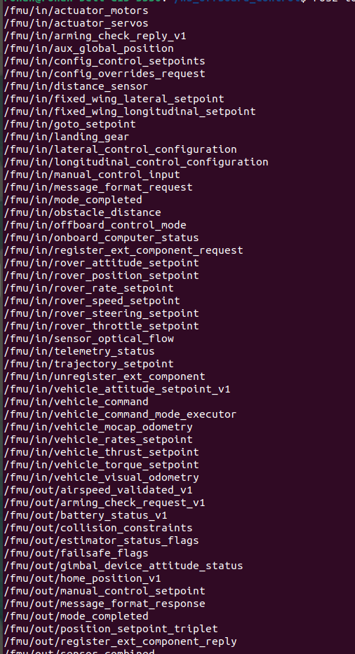
Ros2 Topic List

Slide 15
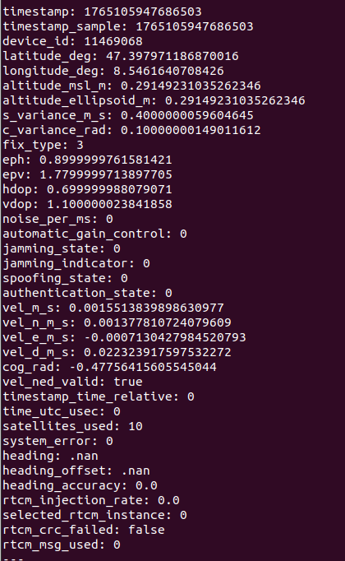
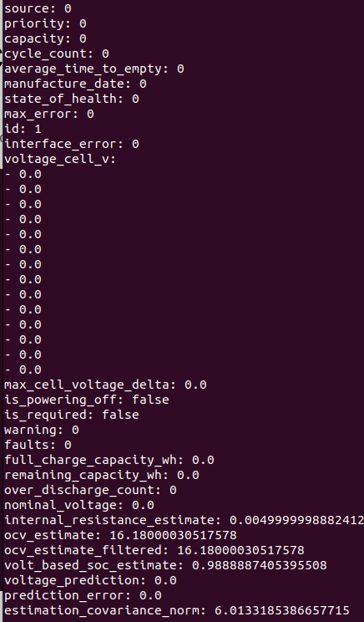
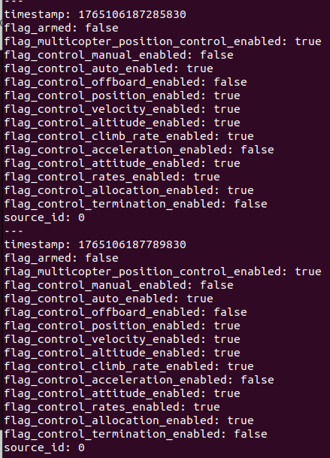
Ros2 Topic Echo
ros2 topic echo /fmu/out/vehicle_gps_position
ros2 topic echo /fmu/out/battery_status_v1
ros2 topic echo /fmu/out/vehicle_control_mode

Slide 16

Creating a Node
Navigate into the top level of your workspace directory and source the ROS 2 environment (in this case "Humble"):
Source the local_setup.bash.
Navigate to ws_offboard_control/build/px4_ros_com/cmake_install.cmake
if("x${CMAKE_INSTALL_COMPONENT}x" STREQUAL "xUnspecifiedx" OR NOT CMAKE_INSTALL_COMPONENT)
file(INSTALL DESTINATION "${CMAKE_INSTALL_PREFIX}/lib/px4_ros_com" TYPE PROGRAM FILES "/home/rohan/ws_offboard_control/src/px4_ros_com/src/examples/offboard_py/initializeOffboard.py")
endif()
Colcon Build

Slide 17
Running a Node
Now launch the example. Note here that we use ros2 run, which is described below.
ros2 run px4_ros_com initializeOffboard.py - Initialize OFFBOARD and send Continuous
Initialize OFFBOARD Mode
Creates a ROS2 node.
Publishes OffboardControlMode + TrajectorySetpoint at 10 Hz.
After sending 10 initial setpoints, it:
Requests OFFBOARD mode
Sends ARM command
Keeps streaming position setpoints to control the drone in PX4 Offboard Mode.
This is the minimum viable offboard control node.

Slide 18
Understanding PX4 Offboard Control Using ROS 2 — Code Walkthrough
We are going to walk through
Initialize OFFBoard Mode
Creating a square
Position Control Node

